Slide 1
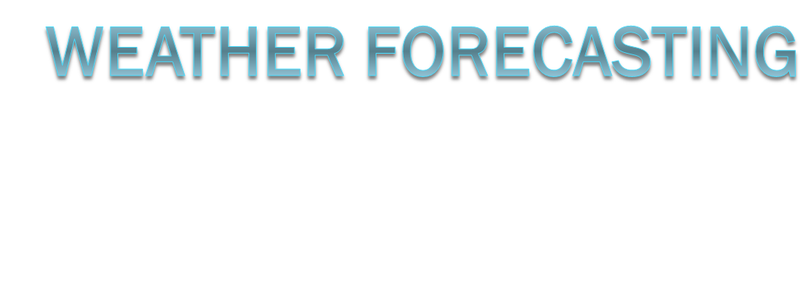

Slide 2
Acquisition of Weather Information
10,000 land-based stations, hundreds of ships and buoys; four times a day, airports hourly
Upper level: radiosonde, aircraft, satellites
United Nations World Meteorological Organization, 175 countries
World Meteorological Centers: Melbourne, Moscow, Washington D.C.
NCEP, US NWS
ASOS

Slide 3
Weather Forecasting Tools
High speed data modeling systems (AWIPS): communication, storage, processing, and display
Doppler radar
Satellite imagery
Forecast charts
Soundings
Wind profiles

Slide 4
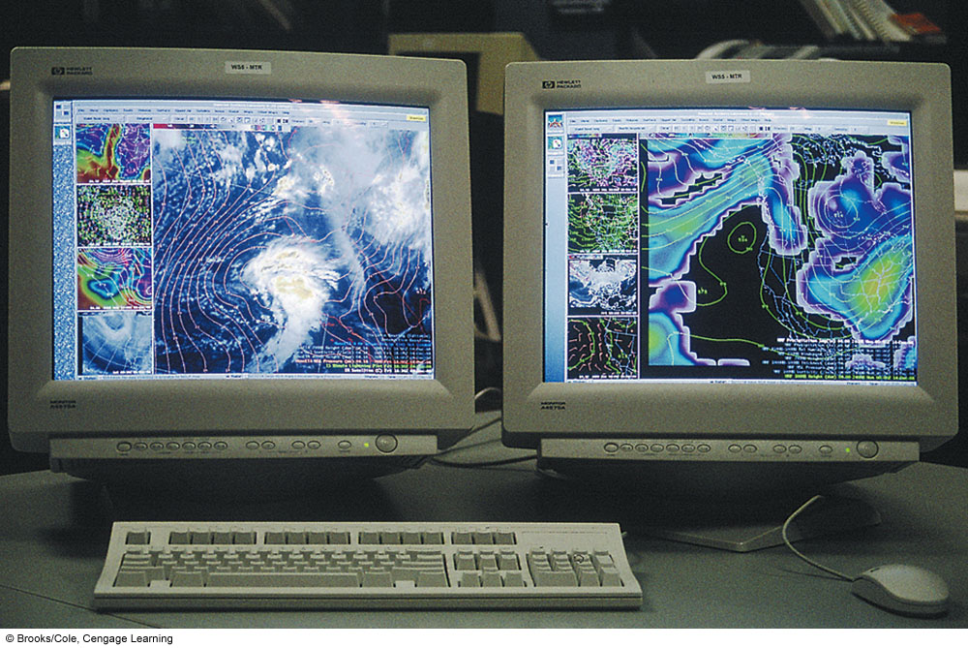
Notes:
FIGURE 13.1 The AWIPS computer workstation provides various weather maps and overlays on different screens. An Analysis give the current condition everywhere at some particular time. Because of data collection spacing the analysis is our “best estimate” as to the current conditions. Numerical weather prediction models estimate future conditions starting from a particular analysis to generate a prognostic chart (weather forecast)

Slide 5
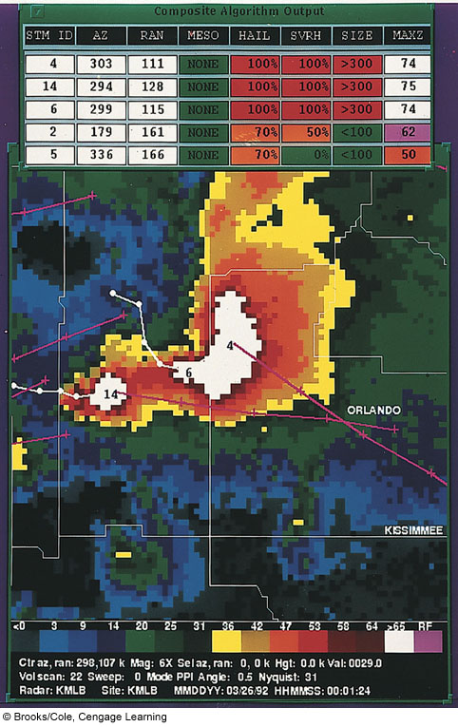
Notes:
FIGURE 13.2 Doppler radar data from Melbourne, Florida, during the time of a severe hailstorm in the Orlando area. In the table near the top of the display, the hail algorithm determined that there was 100 percent probability that the storm was producing hail and severe hail. The algorithm also estimated the maximum size of the hailstones to be greater than 3 inches. A forecaster can project the movement of the storm and adequately warn those areas in the immediate path of severe weather.

Slide 6
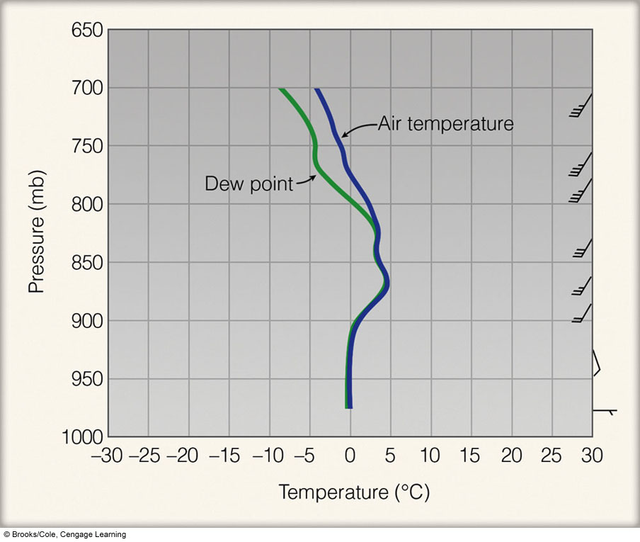
Notes:
FIGURE 13.4 A sounding of air temperature, dew point, and winds at Pittsburgh, PA, on January 14, 1999. Looking at this sounding, a forecaster would see that saturated air extends up to about 820 mb. The forecaster would also observe that below-freezing temperatures only exist in a shallow layer near the surface and that the freezing rain presently falling over the Pittsburgh area would continue or possibly change to rain, as cold easterly surface winds are swinging around to warmer southwesterly winds aloft.

Slide 7
Weather Forecasting Tools
Topic: Watches, Warnings, and Advisories
  Advisories: potential hazardous conditions; wind, wind chill, heat, urban and small stream, snow, dense fog
  Watch: atmospheric conditions favoring hazardous weather over a region in time, actual location and time not known; flash flood, severe thunderstorm, tornado, hurricane
  Warning: imminent or occurring hazardous weather over a region in time; high wind, heat, flash flood, severe storm, tornado, hurricane, winter storm, blizzard, gale, storm

Slide 8
Weather Forecasting Methods
1950s maps, charts plotted by hand
Numerical weather prediction
  Solves equations using gridded data
  Final chart called analysis
  24 hr forecast for the N Hemisphere requires millions of calculations
  Resolution
  Guidance/ rules of thumb

Slide 9
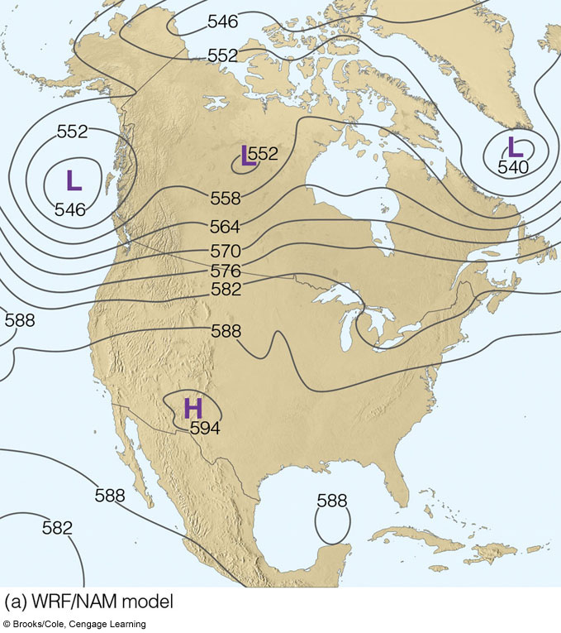
Notes:
FIGURE 13.5 Two 500-mb progs for 7 p.m. EST, July 12, 2006 — 48 hours into the future. Prog (a) is the WRF/NAM model,
with a resolution (grid spacing) of 12 km, whereas prog (b) is the GFS model with a resolution of 60 km. Solid lines on each map are
height contours, where 570 equals 5700 meters. Notice how the two progs (models) agree on the atmosphere’s large scale circulation.
The main difference between the progs is in the way the models handle the low off the west coast of North America. Model
(a) predicts that the low will dig deeper along the coast, while model (b) predicts a more elongated west-to-east (zonal) low.

Slide 10
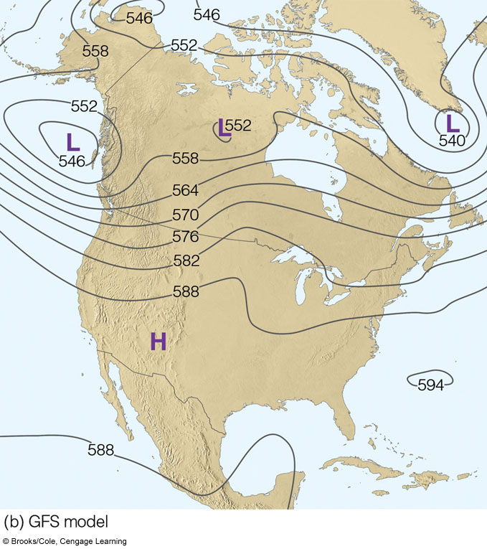
Notes:
FIGURE 13.5 Two 500-mb progs for 7 p.m. EST, July 12, 2006 — 48 hours into the future. Prog (a) is the WRF/NAM model,
with a resolution (grid spacing) of 12 km, whereas prog (b) is the GFS model with a resolution of 60 km. Solid lines on each map are
height contours, where 570 equals 5700 meters. Notice how the two progs (models) agree on the atmosphere’s large scale circulation.
The main difference between the progs is in the way the models handle the low off the west coast of North America. Model
(a) predicts that the low will dig deeper along the coast, while model (b) predicts a more elongated west-to-east (zonal) low.

Slide 11
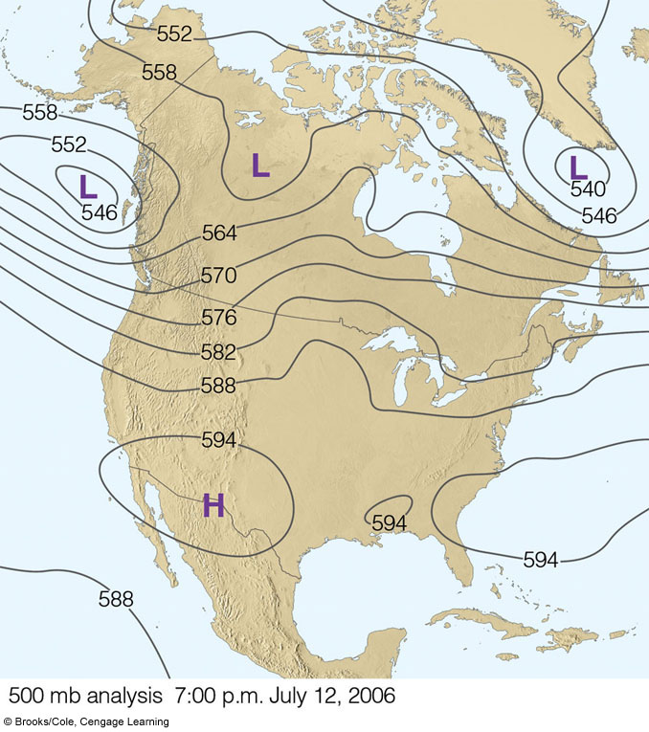
Notes:
FIGURE 13.6 The 500-mb analysis for 7 p.m. EST, July 12, 2006.

Slide 12
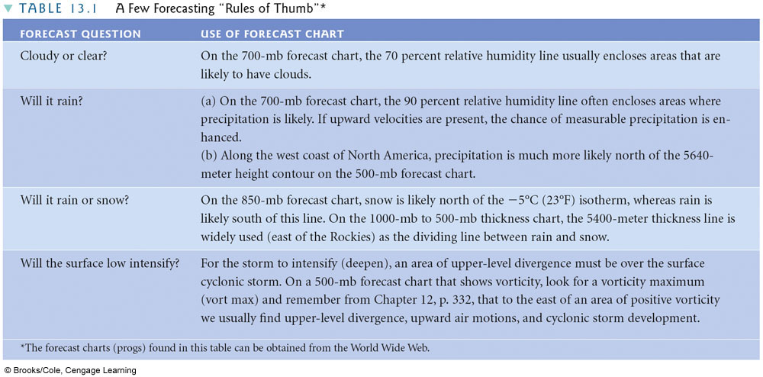
Notes:
TABLE 13.1 A Few Forecasting “Rules of Thumb”*

Slide 13
Weather Forecasting Methods
Topic: Thickness Charts
  Difference in height between two constant pressure surfaces (100mb-500mb)
  Higher thickness equals warmer air
Why Forecast Go Awry
  Assumptions
  Models not global
  Regions with few observations
  Cannot model small-scale features
  All factors cannot be modeled
Ensemble Forecasts:
  Spaghetti model, robust

Slide 14
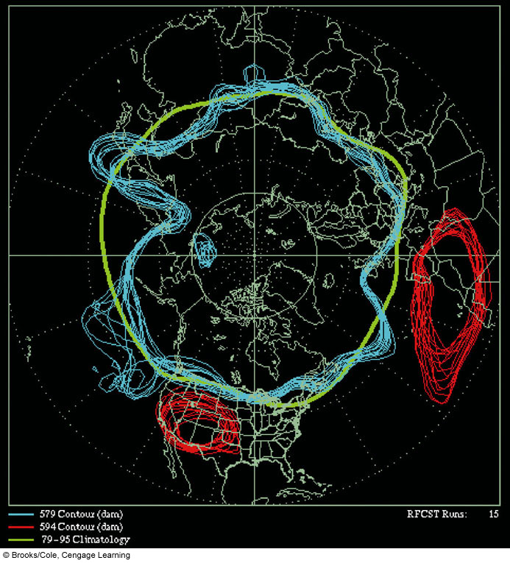
Notes:
FIGURE 13.7 Ensemble 500-mb forecast chart for July 21, 2005 (48 hours into the future). The chart is constructed by running the model 15 different times, each time beginning with a slightly different initial condition. The blue lines represent the 5790-meter contour line; the red lines, the 5940-meter contour line; and the green line, the 500-mb 25-year average, called climatology.

Slide 15
Weather Forecasting Methods
Other Forecasting Techniques
  Persistence
  Trend
  Analogue
  Statistical
  Weather type
  climatological

Slide 16
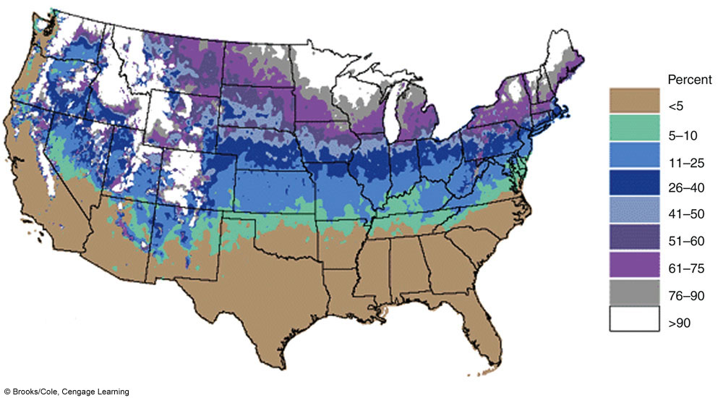
Notes:
FIGURE 13.8 Probability of a “White Christmas” — one inch or more of snow on the ground — based on a 30-year average.
The probabilities do not include the mountainous areas in the western United States. (NOAA)

Slide 17
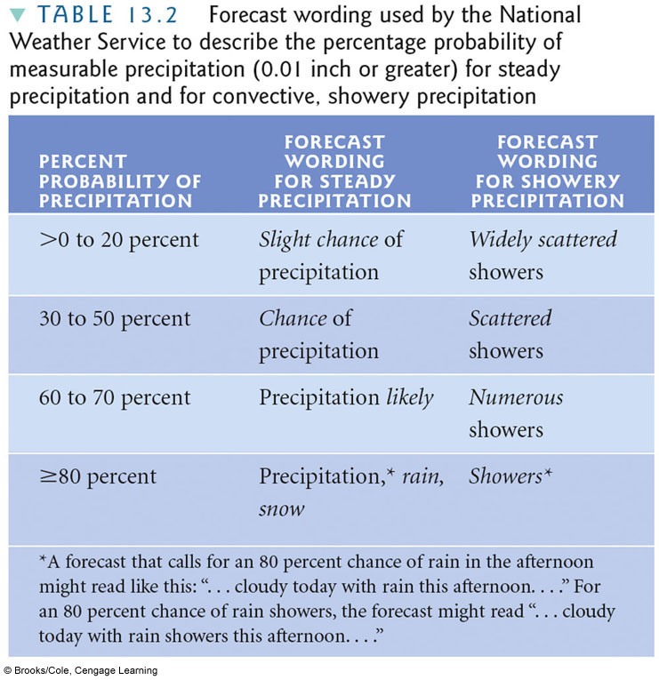
Notes:
TABLE 13.2 Forecast wording used by the National
Weather Service to describe the percentage probability of
measurable precipitation (0.01 inch or greater) for steady
precipitation and for convective, showery precipitation

Slide 18
Weather Forecasting Methods
Observation: Weathercasters
  Chroma key or color separation
Types of Forecasts
  Now cast <6 hrs
  Short range 12-65 hrs
  Medium range 3-8.5 days
  Long Range >8.5 days
Accuracy and Skill
  12-24 hrs most accurate, 2-5 days good
  Skill = more accurate than a forecast utilizing persistence of climatology

Slide 19
Weather Forecasting Using Surface Charts
Observation: Advection
  Winds that back with height indicate cold advection (counterclockwise) and vice versa
Movement of Weather Systems
Mid-lat cyclones move in same direction and speed as previous 6 hrs
Lows move in direction parallel the isobars in the warm air ahead of the cold front
Lows move toward region of greatest pressure drop

Slide 20
Forecasting :
Accuracy and skill
A persistent forecast or climatological forecast is often accurate. Forcasting a warm sunny day in LA during the summer is often accurate.
To show forecast skill the forecaster must do better than either the persistent forecast or climatological forecast. Correctly Forecasting a rainy day during the summer in LA takes skill.

Slide 21
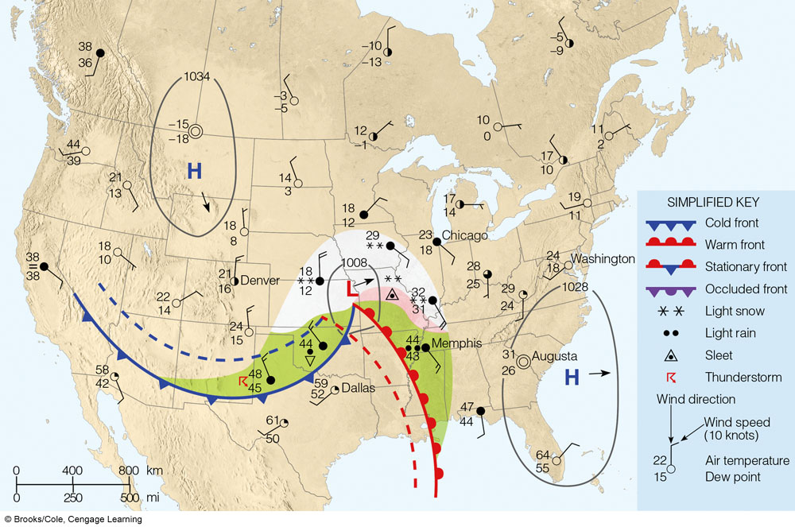
Notes:
FIGURE 13.12 Surface weather map for 6:00 a.m. Tuesday. Dashed lines indicate positions of weather features six hours ago. Areas
shaded green are receiving rain, while areas shaded white are receiving snow, and those shaded pink, freezing rain or sleet.

Slide 22
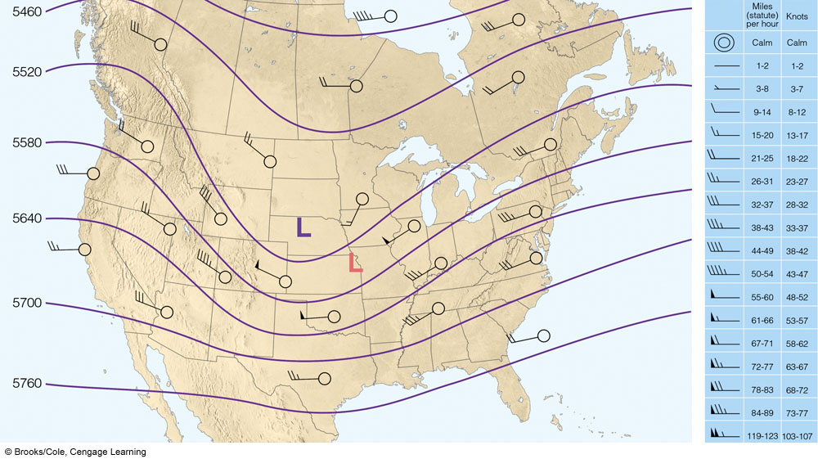
Notes:
FIGURE 13.14 A 500-mb chart for 6:00 a.m. Tuesday, showing wind flow. The light orange L represents the position of the surface
low. The winds aloft tend to steer surface pressure systems along and, therefore, indicate that the surface low should move northeastward
at about half the speed of the winds at this level, or 25 knots. Solid lines are contours in meters above sea level.

Slide 23
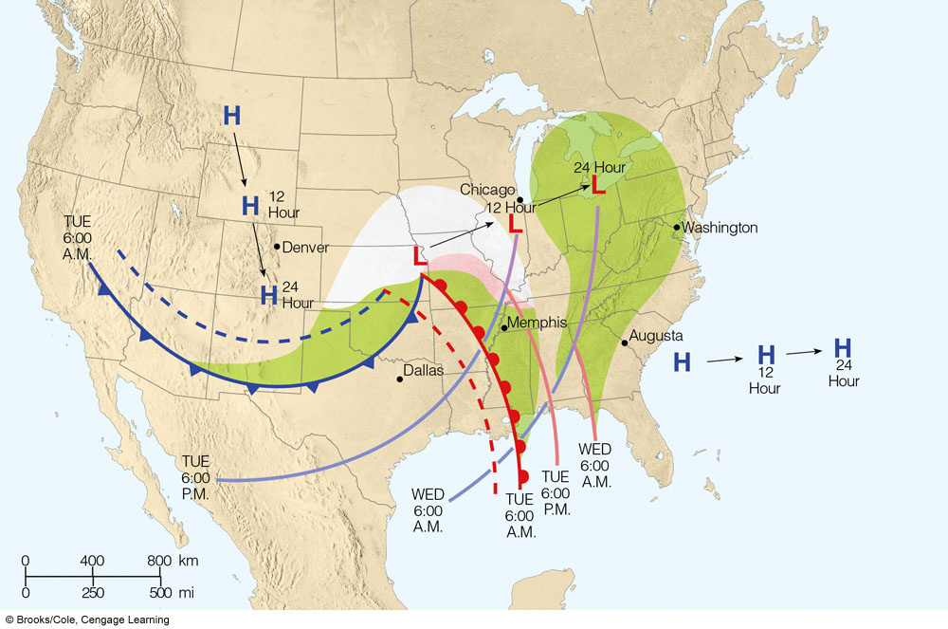
Notes:
FIGURE 13.15 Projected 12- and 24-hour movement of fronts, pressure systems, and precipitation from 6:00 a.m. Tuesday until
6:00 a.m. Wednesday. (The dashed lines represent frontal positions 6 hours ago.)

Slide 24
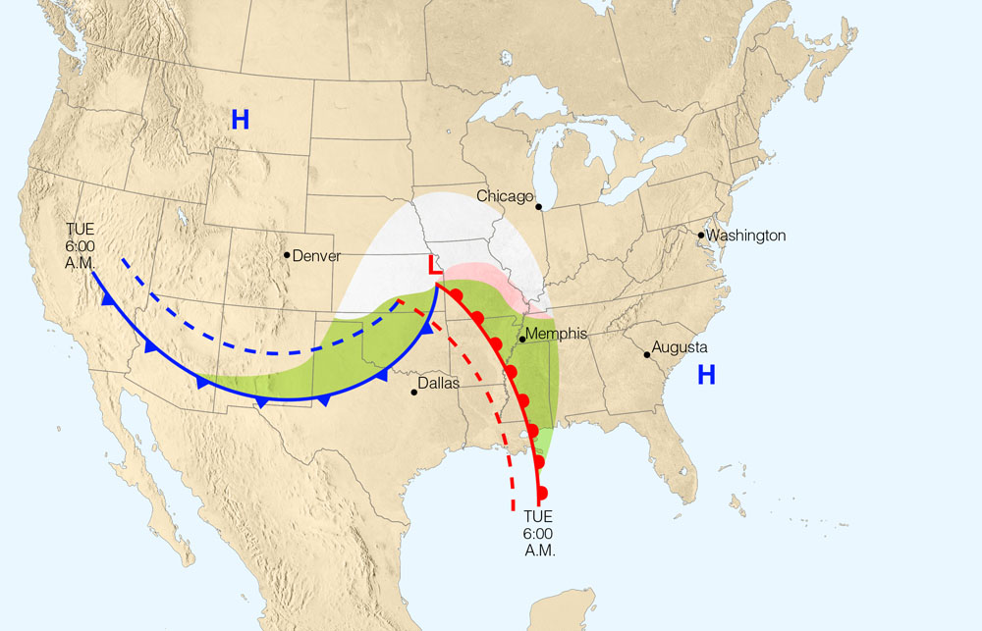
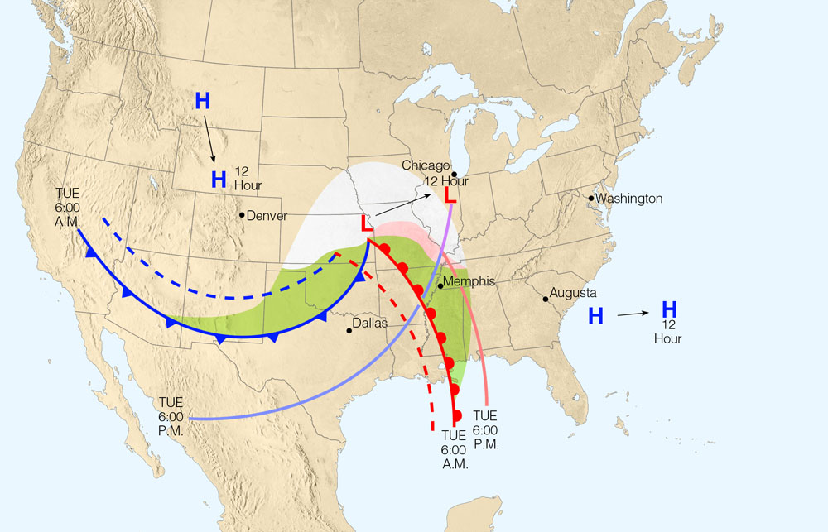
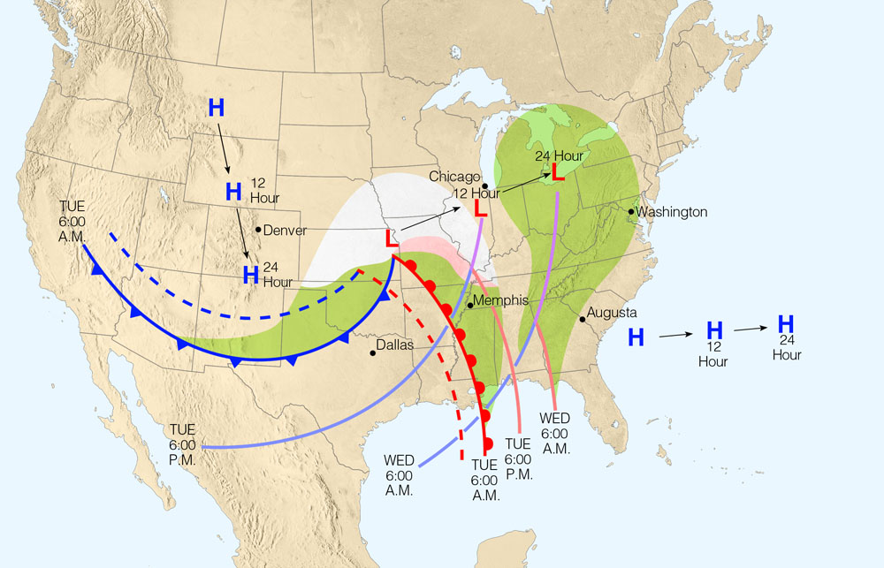
Stepped Art
Fig. 13-15, p. 359
Notes:
Figure 9.21: Projected 12- and 24-hour movement of fronts, pressure systems, and precipitation from 6:00 A.M. Tuesday until 6:00 A.M. Wednesday. (The dashed lines represent frontal positions 6 hours ago.)

Slide 25
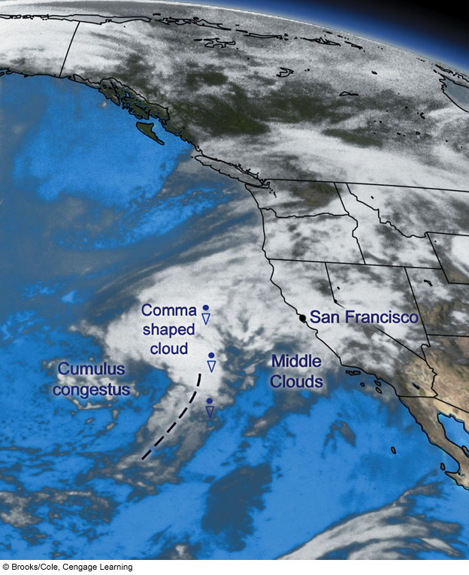
Notes:
FIGURE 13.22 Infrared satellite image taken at 6:45 a.m. (PST) Monday, March 26. The cloud in the shape of a comma indicates that
the mid-latitude cyclonic storm is deepening. (The heavy dashed line shows the tail of the comma cloud.)

Slide 26
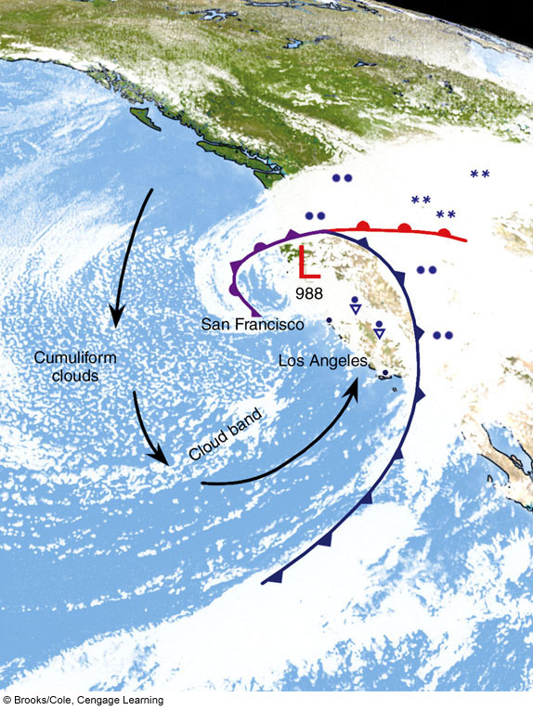
Notes:
FIGURE 13.24 Visible satellite image for 9:00 a.m. (PST) Tuesday, March 27. Included in the picture are the positions of surface
fronts, the upper-level flow (heavy arrows), and precipitation patterns.

Slide 27

This presentation is brought to you by:
LAVANYA AND ALKA GUPTA

